Slide 1
RENTAL BIKE SHARE DEMAND PREDICTION
DETAILED PROJECT REPORT
PIYUSH AGGARWAL

Slide 2
Title: | Rental Bike Share Prediction
Technologies: | Machine Learning
Domain: | Transport
Project Difficulty level: | Intermediate
Programming language: | Python
Tools used: | Vscode,Jupyter Notebook,Github, railway.app

Slide 3

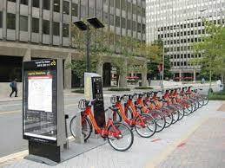
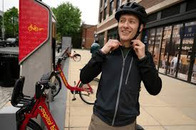
Bike sharing systems are a new generation of traditional bike rentals where the whole process from membership, rental and return back has become automatic. Through these systems, users are able to easily rent a bike from a particular position and return back at another position. Currently, there are about over 500 bike-sharing programs around the world which is composed of over 500 thousand bicycles. Today, there exists great interest in these systems due to their important role in traffic, environmental and health issues. Apart from interesting real-world applications of bike sharing systems, the characteristics of data being generated by these systems make them attractive for the research.

Slide 4
Problem Statement:
The most important problem from a business point of view for bike-sharing system like Capital Bikeshare is to predict the bike demand on any particular day. While having excess bikes results in wastage of resources (bike maintenance and land/bike stand required for parking and security), having fewer bikes leads to revenue loss (ranging from a short term loss due to missing out on immediate customers to potential longer term loss due to loss in future customer base). Thus having an estimate on the demands would enable efficient functioning of this company Capital Bikeshare.
Objective:
The goal is to combine the historical Bike usage patterns with the weather data and develop a predictive model for forecasting bike rental demand at a particular hour of a particular day based on different conditions like temperature, humidity level. weather, season, hour of the day, month, and so on.

Slide 5
Requirements:
Hardware requirements: A working computer to code with active internet connection.
Tools/Software requirements:
● Python version used for this project 3.9.0 ( This may get updated and
some features might not be available in new version. )
● Python libraries such as NumPy, pandas, matplotlib, seaborn and
scikit-learn ( Used for implementation of machine learning algorithms.)
● Jupyter for Exploratory Data Analysis and testing code, Visual studio code is used as an IDE for writing the code.
● HTML, CSS & Java Scripts are used for developing the front end of
our web application.
● Flask is used for backend development.
● Github is used as the version control system.
● railway.app is used for deployment.

Slide 6
Data Collection:
The dataset was taken from the UCI Machine Learning Repository . Dataset link hour.csv
Bike-sharing rental process is highly correlated to the environmental and
seasonal settings. For instance, weather conditions, day of week, season, hour of the day, etc. can affect the rental behaviors. The core
data set is related to the two-year historical log corresponding to years
2011 and 2012 from Capital Bikeshare system, Washington D.C., USA
which is publicly available at http://capitalbikeshare.com/system-data .We
have taken the data which is hourly based. This data also has data on corresponding weather and seasonal information. Weather
information from http://www.freemeteo.com .

Slide 7
About the dataset in hour.csv file :
Bike sharing counts aggregated on hourly basis. Records available: 17379 .
- instant: record index
- dteday : date
- season : season (1:springer, 2:summer, 3:fall, 4:winter)
- yr : year (0: 2011, 1:2012)
- mnth : month ( 1 to 12)
- hr : hour (0 to 23)
- holiday : weather day is holiday or not (from http://dchr.dc.gov/page/holiday-schedule)
- weekday : day of the week
- workingday : if day is neither weekend nor holiday is 1, otherwise is 0.
+ weathersit :
- 1: Clear, Few clouds, Partly cloudy, Partly cloudy
- 2: Mist + Cloudy, Mist + Broken clouds, Mist + Few clouds, Mist
- 3: Light Snow, Light Rain + Thunderstorm + Scattered clouds, Light Rain + Scattered clouds
- 4: Heavy Rain + Ice Pellets + Thunderstorm + Mist, Snow + Fog
- temp : Normalized temperature in Celsius. The values are divided to 41 (max)
- atemp: Normalized feeling temperature in Celsius. The values are divided to 50 (max)
- hum: Normalized humidity. The values are divided to 100 (max)
- windspeed: Normalized wind speed. The values are divided to 67 (max)
- casual: count of casual users
- registered: count of registered users
- cnt: count of total rental bikes including both casual and registered

Slide 8

Architecture design

Slide 9
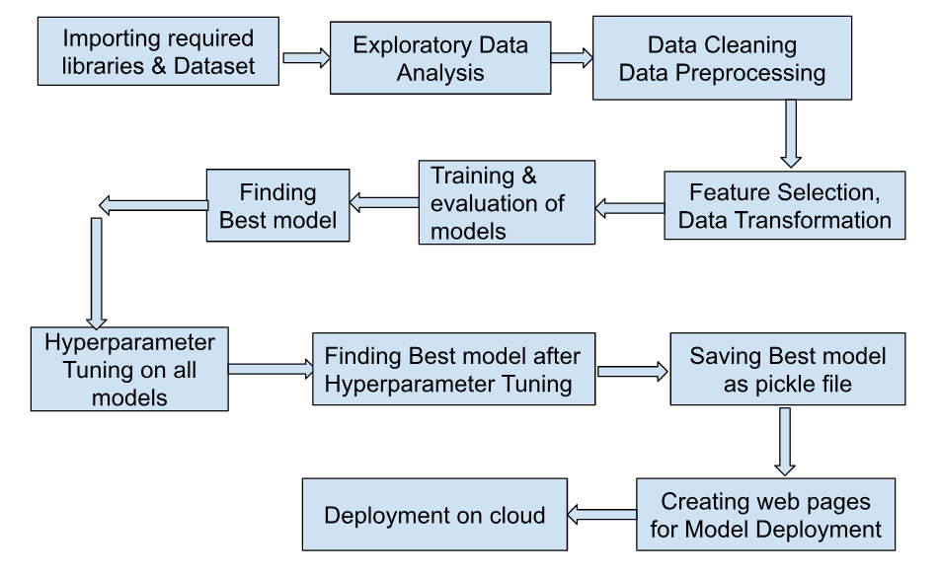
Architecture

Slide 10
Exploratory Data Analysis (EDA)

Slide 11
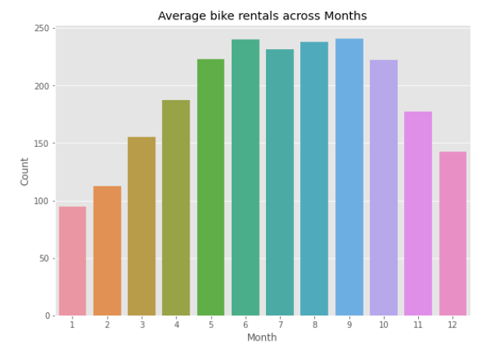
EDA – Monthly Distribution
The trend of increasing use of bike starts from january(lowest) till June then stays almost the same till september and then starts dropping. There's a scope to increase the bike usage in the months from january till May and from October to december. The drop of bike usage from october till December might be explained by the winter season and less bike usage from January to April might be explained by higher windspeed.

Slide 12
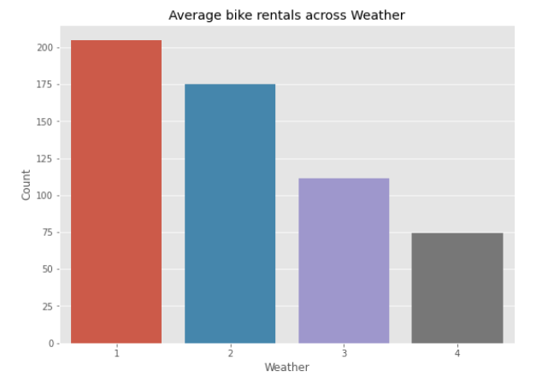
EDA – Weather
Higher bike rental when weather is more clear and sunny
For the given bar plot for weather axis
+ x axis values mean the following:
- 1: Clear, Few clouds, Partly cloudy
- 2: Mist + Cloudy, Mist + Broken clouds, Mist + Few clouds, Mist
- 3: Light Snow, Light Rain + Thunderstorm + Scattered clouds, Light Rain + Scattered clouds
- 4: Heavy Rain + Ice Pallets + Thunderstorm + Mist, Snow + Fog

Slide 13
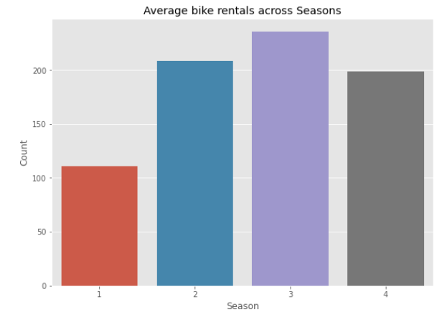
EDA –Season
Highest bike reservations during Summer and Fall and lowest in Spring
Listed X axis values mean the following
1:spring
2:summer
3:fall
4:winter

Slide 14
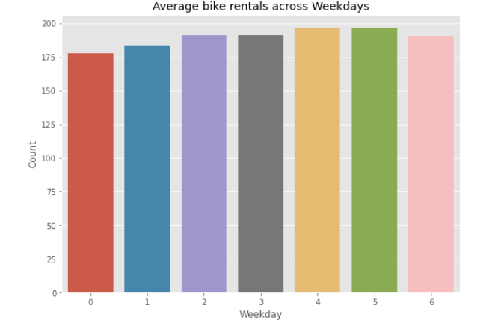
EDA –Weekday
In this graph, we observe an average number of users throughout the week.
Average bike rentals are between 175 and 200 for weekdays
Listed X axis values mean the following
0: Sunday
1: Monday
2: Tuesday
3: Wednesday
4: Thursday
5: Friday
6: Saturday

Slide 15
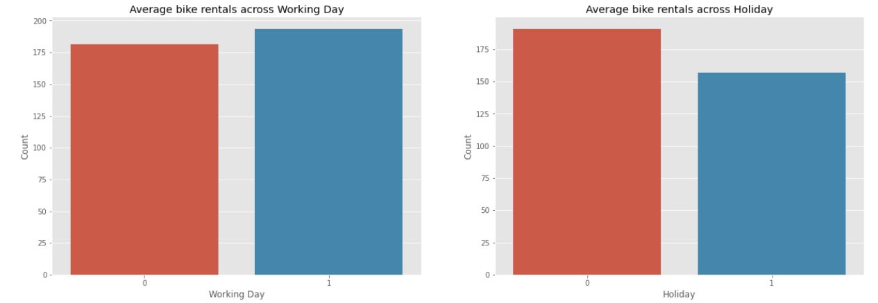
EDA– Working Day/Holiday
Average Bike rental counts for working day and Holidays are as shown below

Slide 16
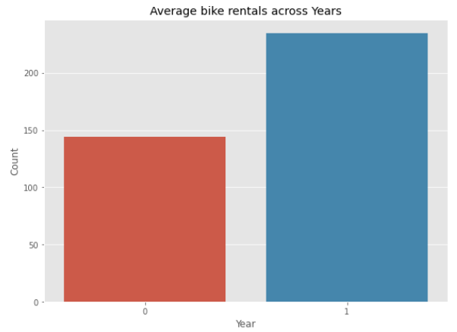
EDA- Year
Average bike rentals are more in year 2012
where 0 means year 2011 and 1: year 2012

Slide 17
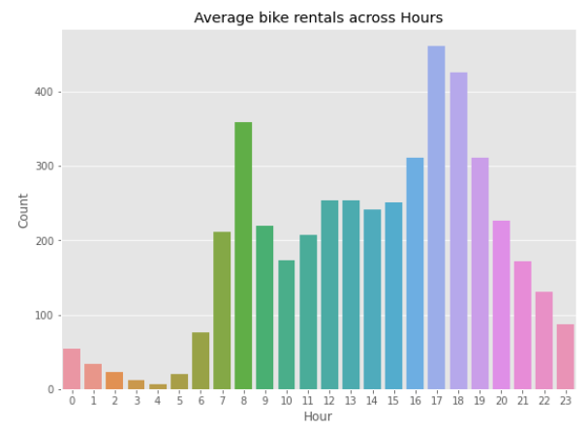
EDA– Hours
Most bike rentals are at 8 am and between 5 to 6 pm around the time when people travel to and fro to office or school and least rentals during early and late hours of a day.

Slide 18
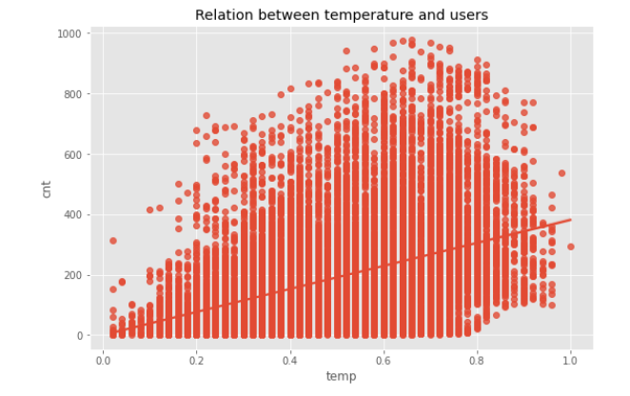
EDA– Temperature
With the increase in temperature, the number of user increases

Slide 19
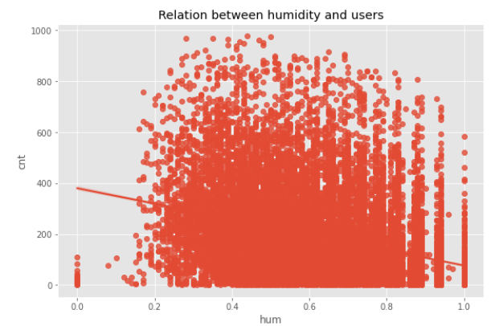
EDA– Humidity
When the humidity increases the number of users renting bikes decreases.

Slide 20
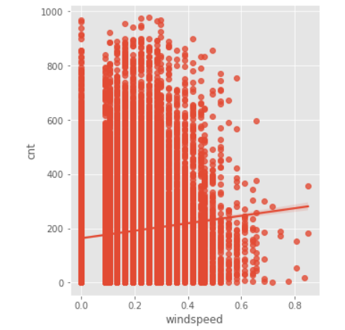
EDA– Windspeed
Regression plot for windspeed looks like follows

Slide 21
Data Preprocessing
● All the necessary libraries were imported first such as Numpy, Pandas, Matplotlib, Seaborn.
● Checking the basic profile of the dataset. To get a better understanding of the dataset.
○ Using Info method
○ Using Describe method
○ Checking for unique values of each column.
● Checking for null values, There are no null values present in our dataset.
● The instant column is just acting as an index column for us, we can drop that column.
● We already have month, weekday, year data as separate columns hence dteday is not required. Hence dropping it.
● We will also be dropping casual and registered column since the cnt column is already feature engineered with addition of casual and registered column in count column (casual+registered=cnt). Also it has been understood that increasing casual or registered users both will be profitable factor for the business.
● Next slide shows dropping of few other columns based on insights from Correlation heatmap

Slide 22
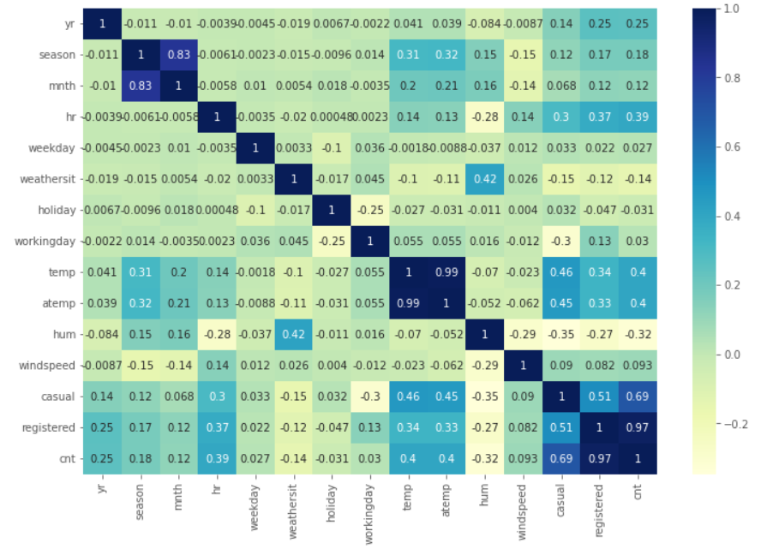
Correlation Analysis Heatmap
temp and atemp are very highly corelated and their respective colinearities with cnt are also same. Hence dropping atemp since feeling temperature can be relatively less accurate compared to temperature.
Dropping holiday column as it is highly correlated to'workingday column.

Slide 23
Remaining Data Preprocessing
● Have converted the integer columns season, yr, mnth, hr, holiday, weekday, workingday, weathersit into categorical columns.
● So, finally following are the predictor variable that will be used for prediction
numerical_columns = ["temp", "hum","windspeed"]
categorical_columns = ["yr","mnth","hr","weekday","season","workingday","weathersit"]
Standard Scaling has been done on Numerical and Categorical columns.
One Hot Encoding has been done on Categorical columns

Slide 24
Model Workflow

Slide 25
Model Workflow - (Model Selection)
● The data was split into 2 sets X and y. X contains all the columns
except the target column in our case ( Count ), y contains only the Target
column.
● Using train test split we first split the dataset into X_train,X_test, y_train,
y_test .
● Following Regression Algorithms were used: CatBoost, Random Forest, Bagging, Decision Tree, Gradient Boost, KNeighbors, Linear Regression.
● After creating the following normal without any hyper tuned models
we get CatBoost Regressor having the highest accuracy of 93.35 on testing data.

Slide 26
Model Workflow - (Model Accuracy score)
● We used Grid Search CV to find the best suiting parameters for
our Catboost Regressor model. Grid Search CV was used on the following set of parameters.
parameters={
"iterations": [1000],
"learning_rate": [1e-3, 0.1],
"depth": [1, 10],
"subsample": [0.05, 1.0],
"colsample_bylevel": [0.05, 1.0],
"min_data_in_leaf": [1, 100]
}

Slide 27
Hyperparameter Tuning on Best Model - Catboost Regressor
Best Hyperparameters Found for this Best Model
colsample_bylevel: is the subsample ratio of columns for each level= 1.0,
depth: Depth of tree= 10,
iterations: number of iterations= 1000,
learning_rate: this setting used for reducing gradient step= 0.1,
min_data_in_leaf: parameter to prevent over-fitting in a leaf-wise tree = 1,
subsample: Subsample ratio of the training instance= 1.0
These best parameters are passed into the CatBoost Regressor model thus creating a Hyper Parameter tuned model.

Slide 28
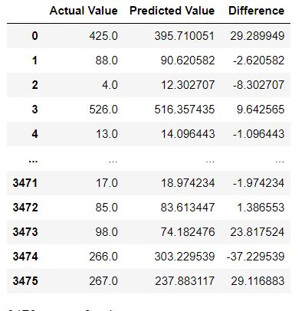
Actual vs Predicted
Table at left shows that there is very less difference between Actual value and Predicted value got from Hypertuned CatBoost Regressor model
Training Accuracy: 98.8%
Testing Accuracy: 94.4%

Slide 29
Comparing Error rate Before and After Hypertuning our CatBoost model
Before Hyperparameter tuning:
Mean Absolute Error: 30.295
Mean Square Error: 2149.264
Root Mean Square Error: 46.360
After Hyperparameter tuning:
Mean Absolute Error: 26.864
Mean Square Error: 1788.167
Root Mean Square Error: 42.286
The model was pickled using the Python pickle library and was ready for use into our Backend system.

Slide 30
Data Collection / Input from the user.
The data from the user is being retrieved from the front-end web page application which is created using HTML , CSS & Java Script. Where users input as shown in the image in next slide.
URL for this web app is: https://bikeshare-demand-prediction-production.up.railway.app/predictdata

Slide 31
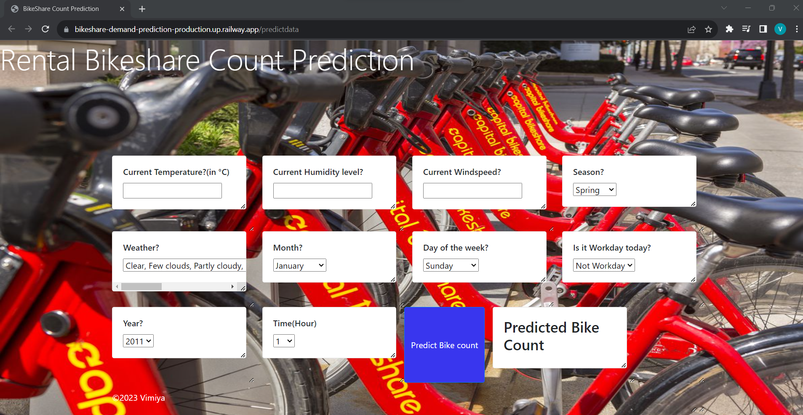
The Web Application page looks like this

Slide 32
Data Validation process
Rendering the result
The data is taken from the frontend web app then sent to the machine learning model but, before that data which is entered by the user and its been validated by the app.py we created as a Flask application.
The data which is taken as the input from the user is sent to the machine learning model and then the result is rendered on the front-end HTML page.

Slide 33
Application Deployment
This model is deployed on railway.app (a platform like Heroku). The following are the steps to deploy this application:
Follow the steps to deploy on railway app using any of the instruction videos available on YouTube.
Best instruction video found:
https://www.youtube.com/watch?v=WzxEHzb2NzM&t=926s

Slide 34
Out of the 7 models tried, CatBoost Regressor model yielded best prediction accuracy of 94.4% on Test Data
We have successfully built an end-to-end web application using machine learning that can help predict the total count of bikes rented by the users based on various conditions.
This type of system can help users to get a better understanding of whether the day is good for riding bikes and make their decision making easier.
This system will help companies to help the users and provide a better end to end user experience, increase efficiency, fulfill bike rental demands,avoid wastage of resources by only deploying required number of bikes thus saving cost and space for parking.
Conclusions

Slide 35
Q & A:
Q1) What’s the source of data?
The dataset was taken from UCI Machine learning repository
https://archive.ics.uci.edu/dataset/275/bike+sharing+dataset
Q 2) What was the type of data?
The data was the combination of numerical and Categorical values.
Q 3) What’s the complete flow you followed in this Project?
Please refer to slide 9 for better Understanding
Q 4) What were the libraries that you used in Python?
I used libraries like Pandas, Numpy, Matplotlib, Seaborn, Scikit-Learn.

Slide 36
Q 5) How logs are managed?
We are mentioning logging information in between the code as it proceeds, the logs are created for steps like Data Ingestion, Train-test split, Obtaining & saving preprocessing object, Names of Categorical & Numerical columns used for prediction, Model Training, Model evaluation, Hyperparameter tuning, Finding best model, etc.
Q 6) What techniques were you using for data pre-processing?
Removing unwanted attributes
Visualizing relation of independent variables with each other and output variables
Checking for outliers
Cleaning data.
Converting certain numeric data to categorical data.
Scaling the data
Also refer slides 21, 22, 23 for more details and understanding.

Slide 37
Q 7) How training was done or what models were used?
Refer slides 24 to 29 for details
Regression Algorithms like Catboost, Bagging, Random Forest, Decision Tree, Gradient Boost, KNeighbors, Linear Regression were used and the best performing model out of all was CatBoost Regression model.
Q 8) Deployment?
Refer slide 33 for details

Slide 38
THANK YOU
PIYUSH AGGARWAL
Project details location: https://github.com/piyushaggarwal93/Bikeshare-Demand-Prediction
Mail: piyushaggarwal22@gmail.com
Linkedin: https://www.linkedin.com/in/vimiya-sebastian-3322501bb/
Github: https://github.com/piyushaggarwal93

